Slide 1
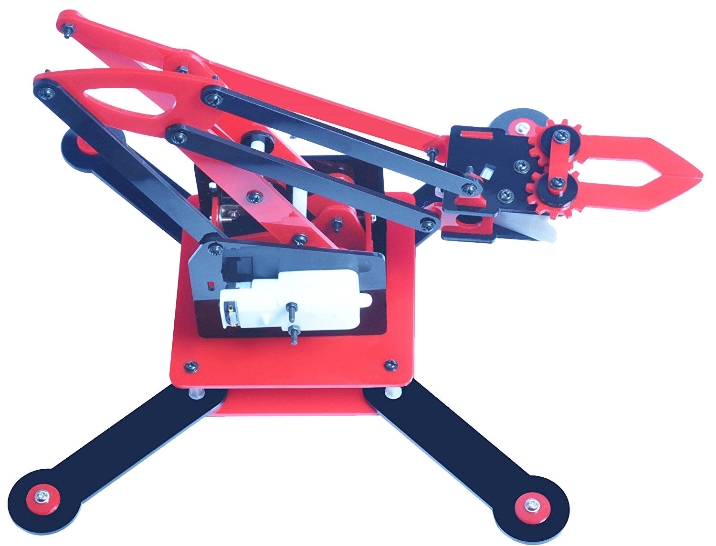

(Robotic Arm- The Soul of Industrial Automation)
EXPERIENTIAL LEARNING CENTRE
COMPUTER SCIENCE AND ENGINEERING DEPARTMENT
THAPAR INSTITUTE OF ENGINEERING AND TECHNOLOGY
PATIALA-147004, PUNJAB INDIA

Slide 2

Problem Statement
A number of situations exist where it is not possible for a human operator to do an activity:- due to a level of danger or difficulty involved. They may involve-
Taking readings from an active volcano
Entering a building on fire
Diffusing a bomb
Collecting a radioactive sample.
Rather than compromising on human lives, it is better to employ robotic systems for performing difficult tasks.

Slide 3
Problem Statement
Robotic systems are far superior in ensuring the accuracy of the system under adverse circumstances wherein a human operator may lose his/her composure and focus.
Here we propose to build a robotic arm controlled by Arduino.
Movements of arm are coded though Arduino.

Slide 4
Learning Outcomes
A robotic arm that can pick items from some place and put it to another place will be built.
This is an elementary step towards industrial automation.
Students will learn basics of robotics and introductory know-how of Arduino programming.

Slide 5
Day - 1
S.No. | Time(hours) | Task | Description
1 | 0930 – 1030 hrs | Introductory Session | Brief description of the challenges of the project.
2 | 1030 – 1100 hrs | Issue hardware | Robotic arm kits and other required hardware will be issued to the students.
3 | 1100 – 1130 hrs | Assemble the arm components | Assemble all the components of the robotic arm which includes a base, sticks, h bridge (shield or breadboard), Arduino, creative hands(form of paper/cardboard),8 core rainbow wire strips, 9v battery.
4 | 1130 – 1230 hrs | Soldering 2-D and 3-D Moments | Making required wired Connection through 8 core rainbow wire strips should be performed with the help of soldering. Perform the 2D and 3D (up, down and rotation) movements of the arm without Arduino.
 | 1230 – 1330 hrs |  | LUNCH BREAK

Slide 6
Day - 1
S.No. | Time(hours) | Task | Description
5 | 1330 – 1430 hrs | Practical Exposure to Arduino -Connecting Arduino with Robotic arm | To study the introduction to Arduino and implement basic programs such as Clockwise/Anticlockwise motion of motor with the help of Arduino. Perform the 2D and 3D (up, down and rotation) anticlockwise and clockwise movements of the arm with Arduino.
6 | 1430 – 1500 hrs | Bronze Challenge | To pick an object from source and drop at right angle from the source location.
7 | 1500 – 1530 hrs | Silver Challenge | Students are given with 3 locations A,B and C (location can be chosen by the student randomly). Firstly, Object is to picked from Location A and has to be drop at location B. Secondly, pick the object from location C and place it on the object which has been previously placed at location B.

Slide 7
Day - 1
S.No. | Time(hours) | Task | Description
8 | 1530 – 1630 hrs | Gold Challenge | Open Ended Applications of Robotic Arms:- a. Robotic Handwriting, b. Cleaning Floor, c. Blood Extraction, d. Painting Robot, e. Anything as per student’s innovation Note:- 1. Students need to bring the material according to the practical application he/she want to perform. For eg. Painting brush in case of designing Painting Robot. Pen, holding clump for pen and paper in case of Robotic Handwriting. 2. In Gold challenge, student can perform any practical application of robotic arm. The aforementioned applications are just few examples.
9 | 1630 – 1715 hrs | Evaluation | Project Evaluation will be done on the basis of student’s idea, creativity, innovation and approach.

Slide 8
Note:-
1. Students need to bring the material according to the practical application he/she want to perform.
For eg. Painting brush in case of designing Painting Robot. Pen, holding clump for pen and paper in case of Robotic Handwriting.
2. In Gold challenge, student can perform any practical application of robotic arm. The aforementioned applications are just few examples.

Slide 9
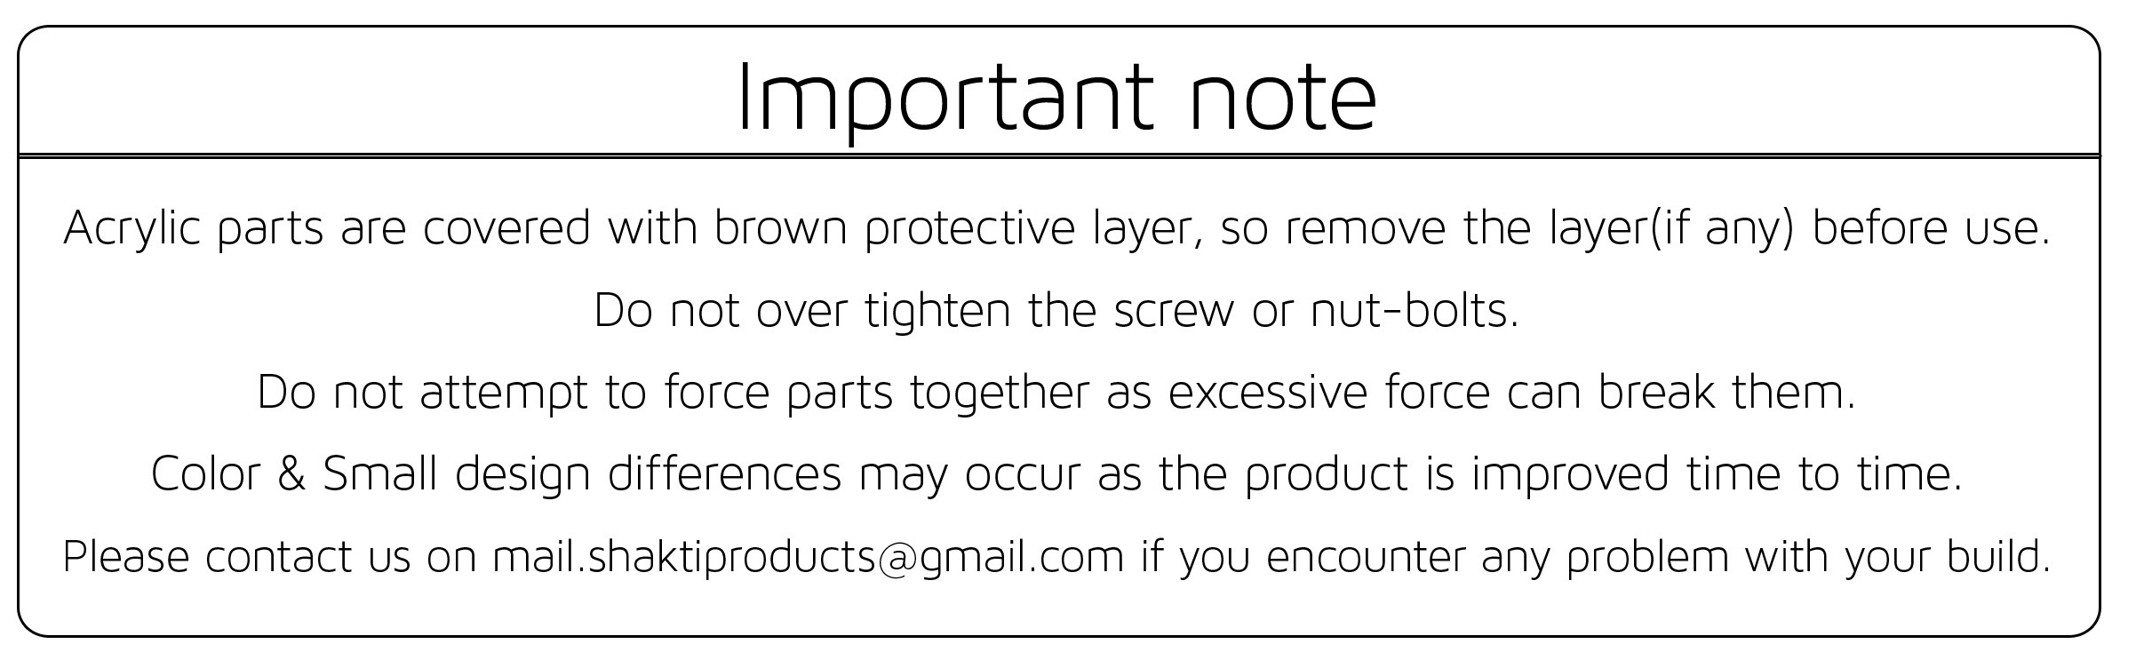
Assembly Manual

Slide 10
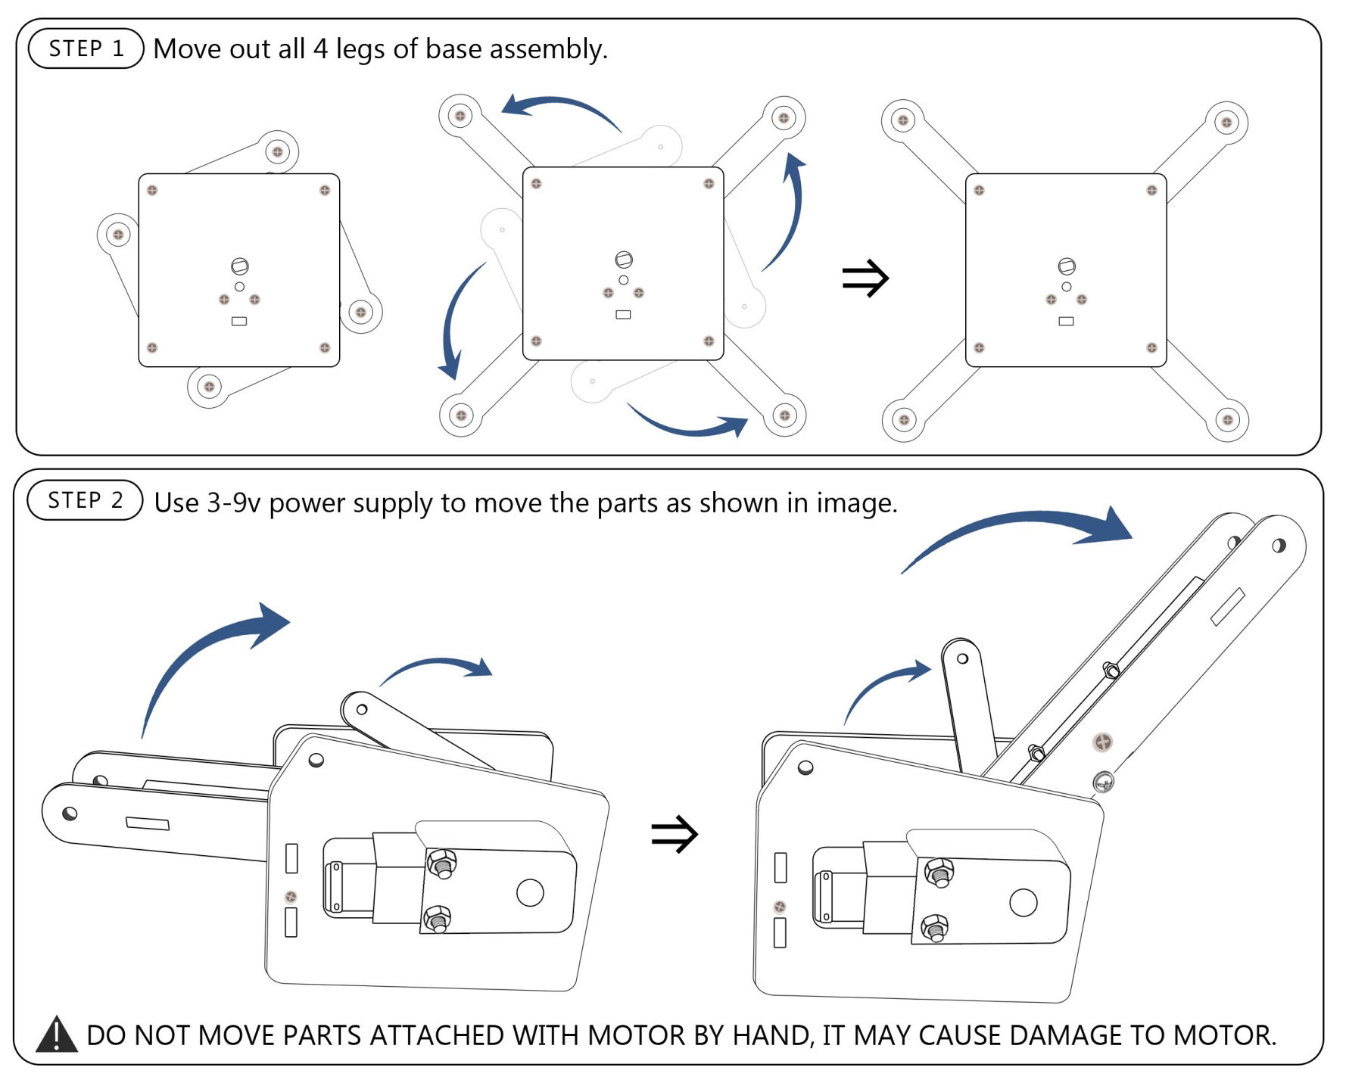

Slide 11
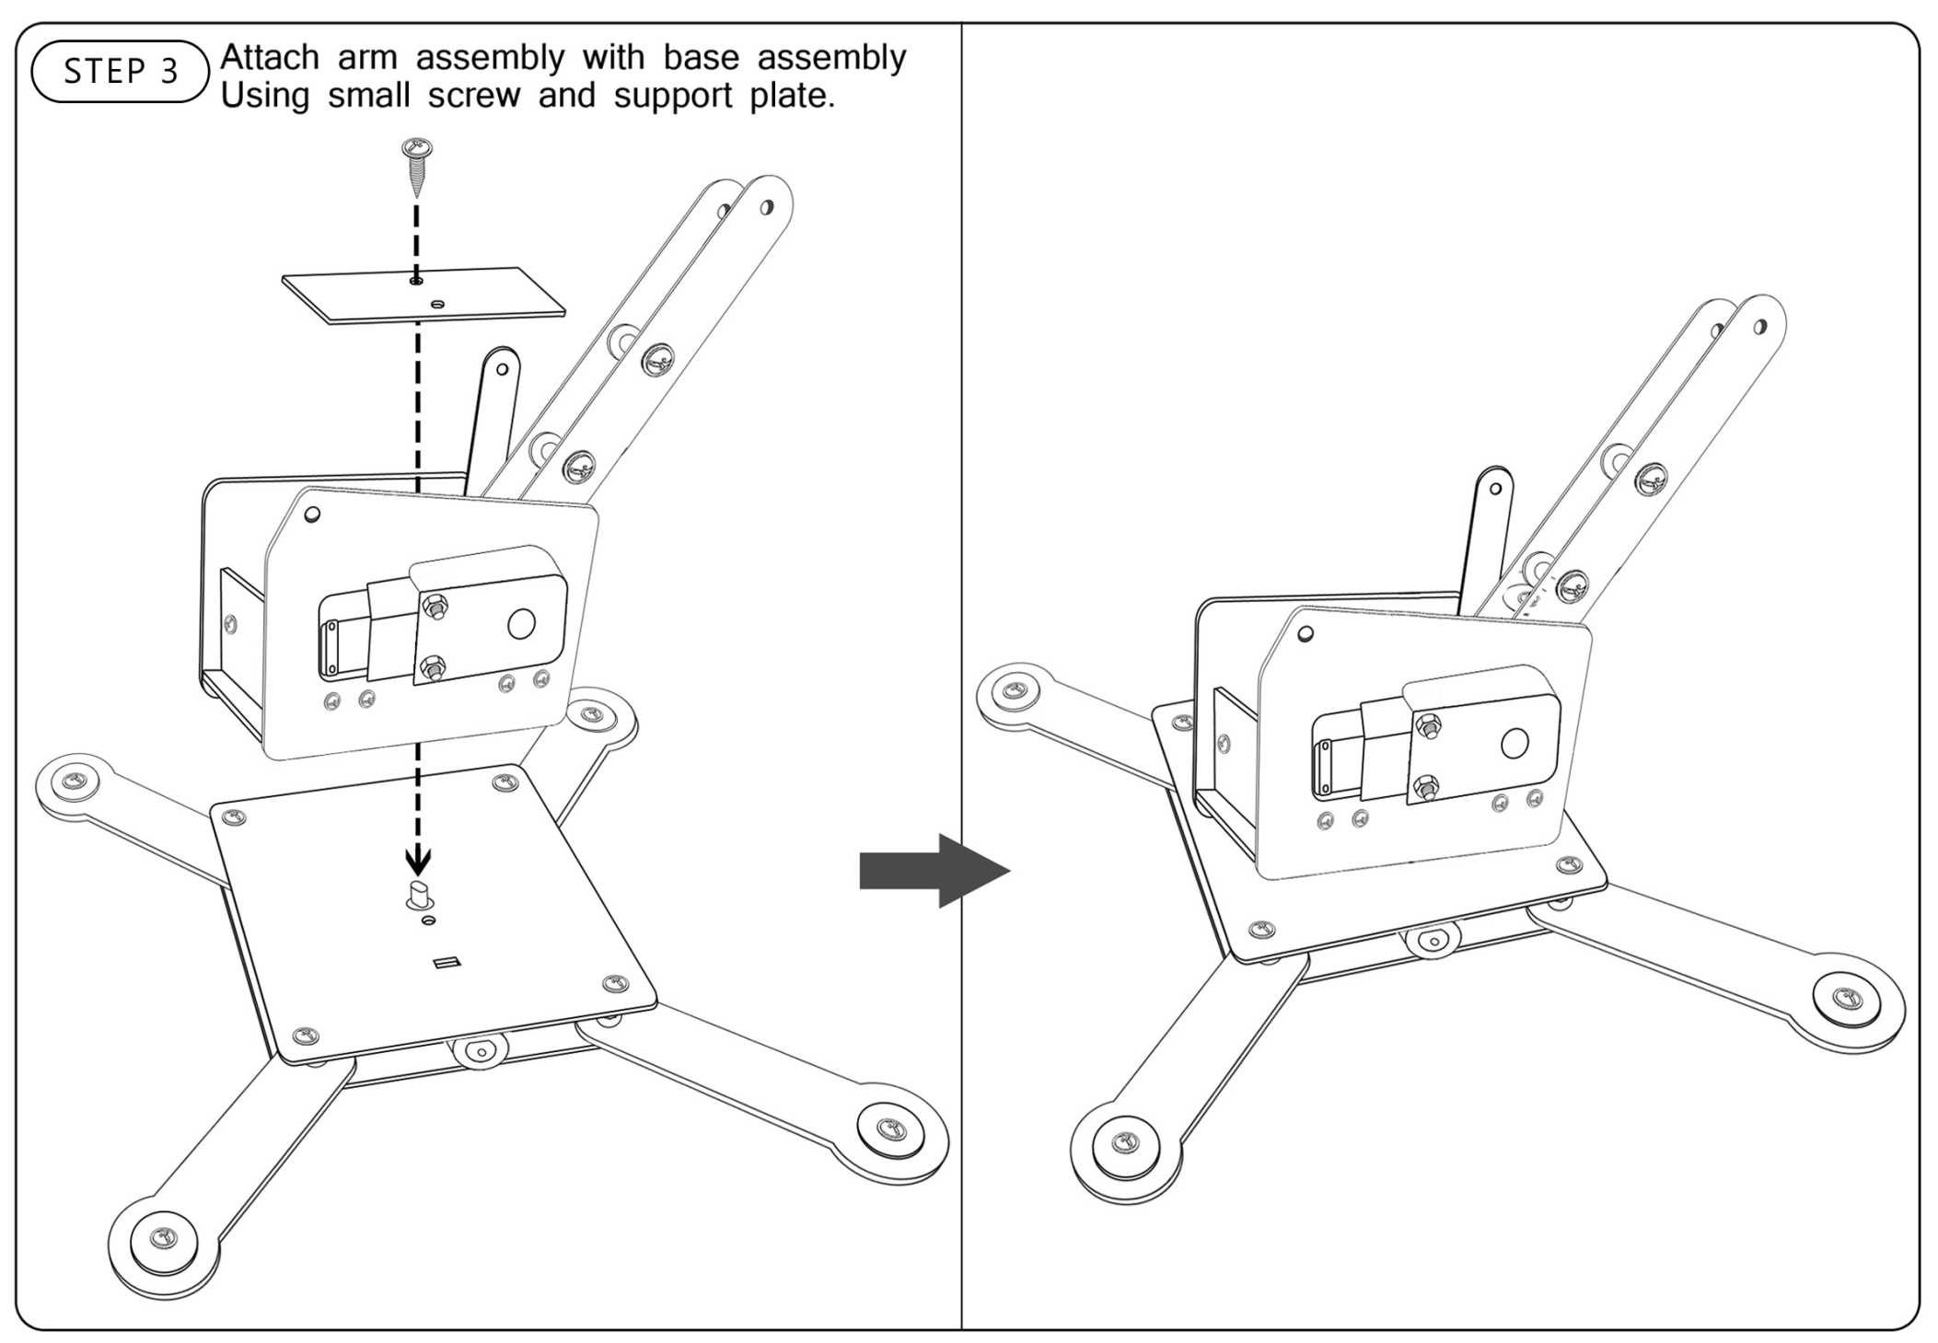

Slide 12
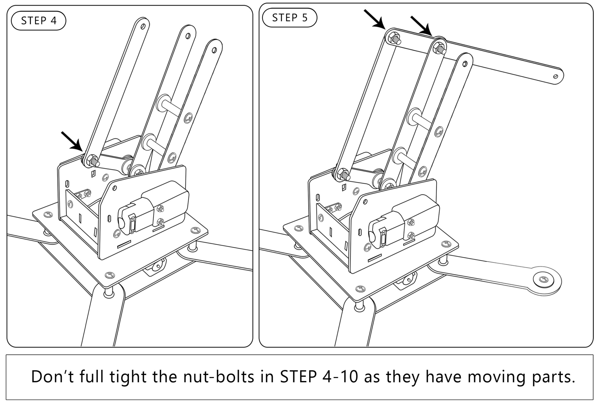

Slide 13
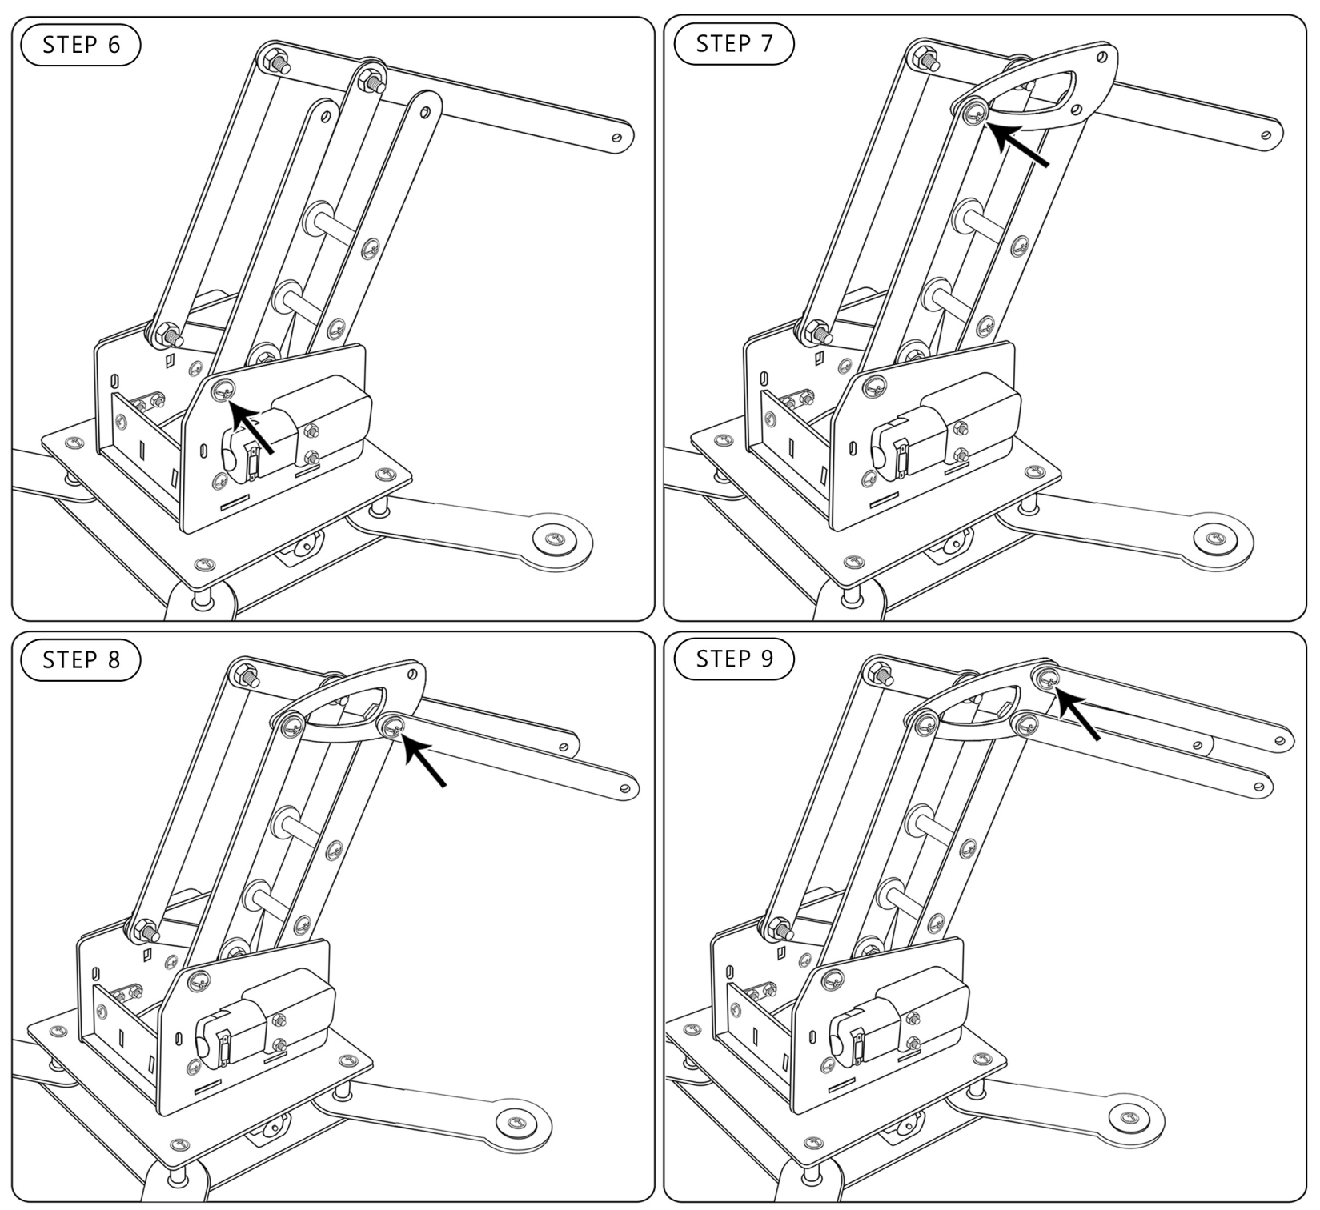

Slide 14
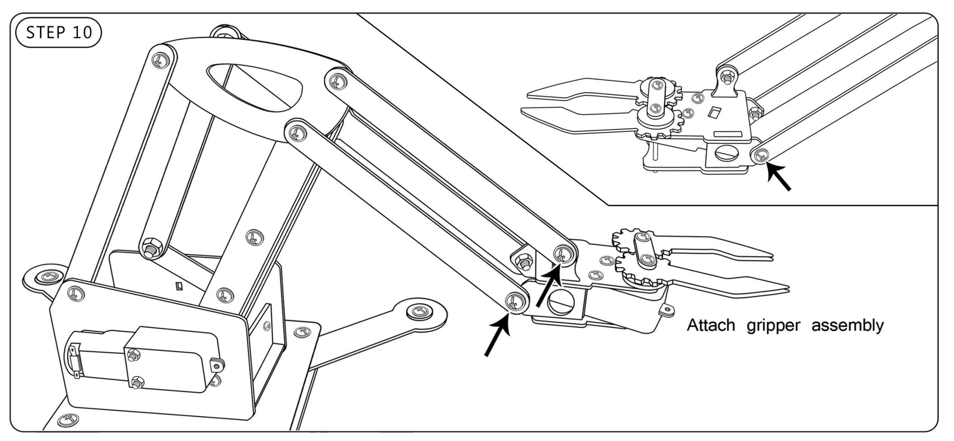

Slide 15
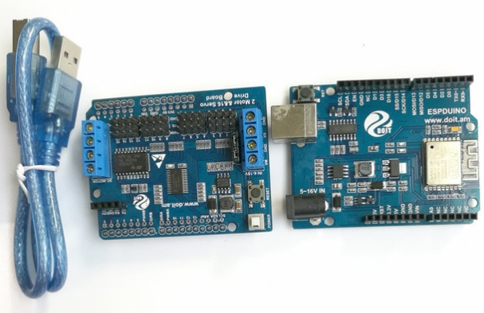

Slide 16
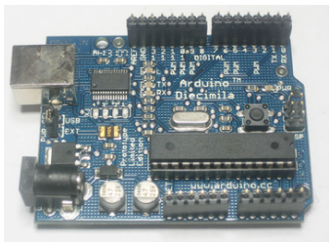
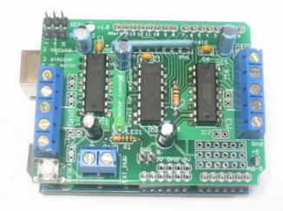
Arduino UNO
Motor shield

Slide 17
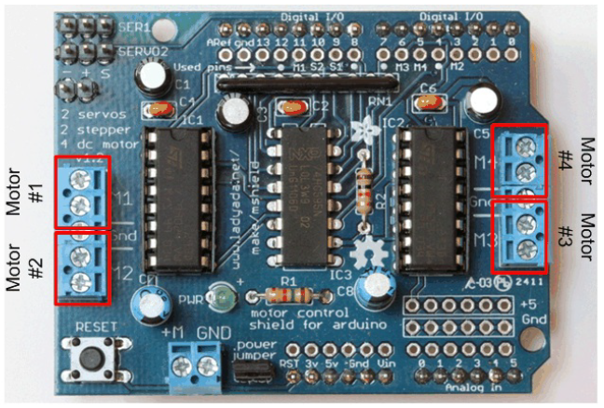

Slide 18
Install Library
Download the library from http://bit.ly/motorShieldLibrary
Uncompress the ZIP file onto your desktop
Rename the uncompressed folder AFMotor
Place the AFMotor folder into your arduinosketchfolder/libraries folder. For Windows, this will probably be something like MY Documents/Arduino/libraries for Mac it will be something likeDocuments/arduino/libraries. If this is the first time you are installing a library, you'll need to create the libraries folder. Make sure to call it libraries exactly, no caps, no other name.
Quit and restart the Arduino. You should now have a submenu called File->Examples->AFMotor->MotorParty
If not, Check that inside the libraries folder there is the AFMotor folder, and inside AFMotor isAFMotor.cpp AFMotor.h and some other files.

Slide 19
Using DC Motors
To connect a motor, simply solder two wires to the terminals and then connect them to either the M1, M2, M3, or M4. Then follow these steps in your sketch
Make sure you include library
#include <AFMotor.h>
Create the AF_DCMotor object with AF_DCMotor(motor#)
Motor# tells motor is connected to which port, 1, 2, 3 or 4.
Then you can set the speed of the motor using setSpeed(speed) where the speed ranges from 0 (stopped) to 255 (full speed). You can set the speed whenever you want.
To run the motor, call run(direction) where direction is FORWARD, BACKWARD or RELEASE.
RELEASE – Stops motor
FORWARD/BACKWARD – Runs motor Clockwise/anticlockwise (it depends how you connect motor to battery)

Slide 20
Using Arduino IDE
Each Arduino file is called sketch
When you open Arduino IDE, you would see 2 functions written in sketch
setup()
loop()
setup()
The setup() function is called when a sketch starts. Use it to initialize variables, pin modes, start using libraries, etc. the setup() function will only run once, after each powerup or reset of the Arduino board.
4. loop()
The loop() function does precisely what its name suggests, and loops consecutively, allowing your program to change and respond. Use it to actively control the Arduino board.

Slide 21
Include library and setup()
#include <AFMotor.h>
AF_DCMotor motor(2); // create motor #2
void setup() {
Serial.begin(9600); // set up Serial library at 9600 bps
Serial.println("Motor test!");
motor.setSpeed(200); // set the speed to 200/255
}

Slide 22
Loop()
void loop() {
Serial.print("tick");
motor.run(FORWARD); // turn it on going forward
delay(1000);
Serial.print("tock");
motor.run(BACKWARD); // the other way
delay(1000);
Serial.print("tack");
motor.run(RELEASE); // stopped
delay(1000);
}

Slide 23
Important Instructions:-
Laptops are mandatory for all students.
Gold challenge -- Students need to bring the supporting material according to the practical application he/she want to perform. For eg. Painting brush, paint in case of designing Painting Robot. Pen, holding clump for pen and paper in case of Robotic Handwriting. Plastic container, Small cloth or rubber with any support(pen or pencil in case of Floor cleaning. For more info. :- refer to point 4 on page 4 of Day 2.
Participation of every student is mandatory.
Team of 5-7 members is required on strictly basis. You can make team according to your choice from the attached list.
Students are required to present as per attached schedule only. No request of group change will be entertained.
Moderate proficiency in Arduino Programming is required.

